Slide 1


Us Craft Beer Analysis
Authors: William Arnost and Meisam A. Mansor
Audience: Carlos Brito, CEO of Anheuser-Busch InBev
Files available at: https://github.com/warnost/CaseStudy01

Slide 2



We analyzed two data sets
Beer Data
Info on 2410 US Craft Beers
Name
Style
Alcohol Content (ABV)
Bitterness (IBU)
Serving Size (Oz)
Brewery ID
Brewery Data
Geographic data for 558 Breweries
Name
City
State
Brewery ID

Slide 3
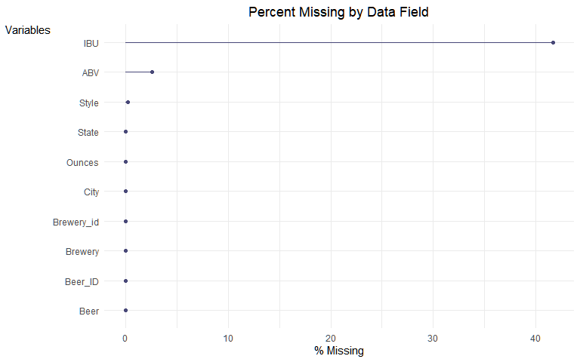

Missing Data
IBU is missing 42% of its data
ABV is missing 3%
Style is missing 0% (5 obs.)

Slide 4
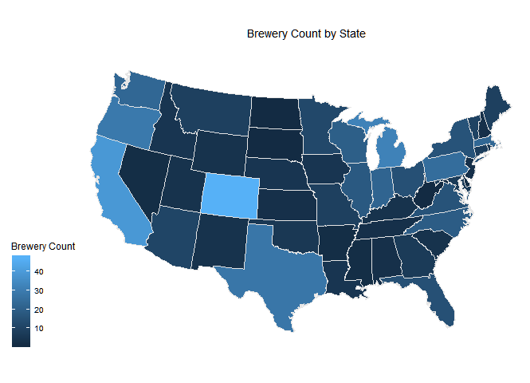

Brewery Count by State
Brewery Count by State
1. Colorado (47)
2. California (39)
3. Michigan (32)
4. Oregon (29)
5. Texas (28)
Brewery Count
* Alaska and Hawaii are omitted

Slide 5
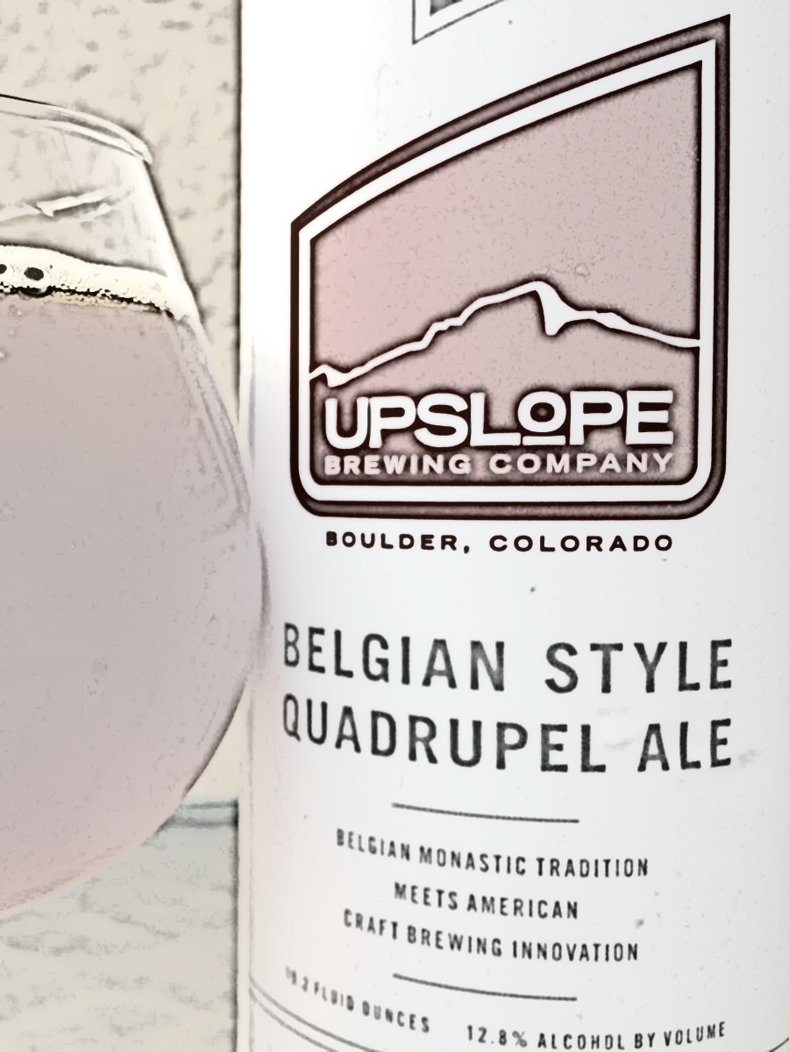
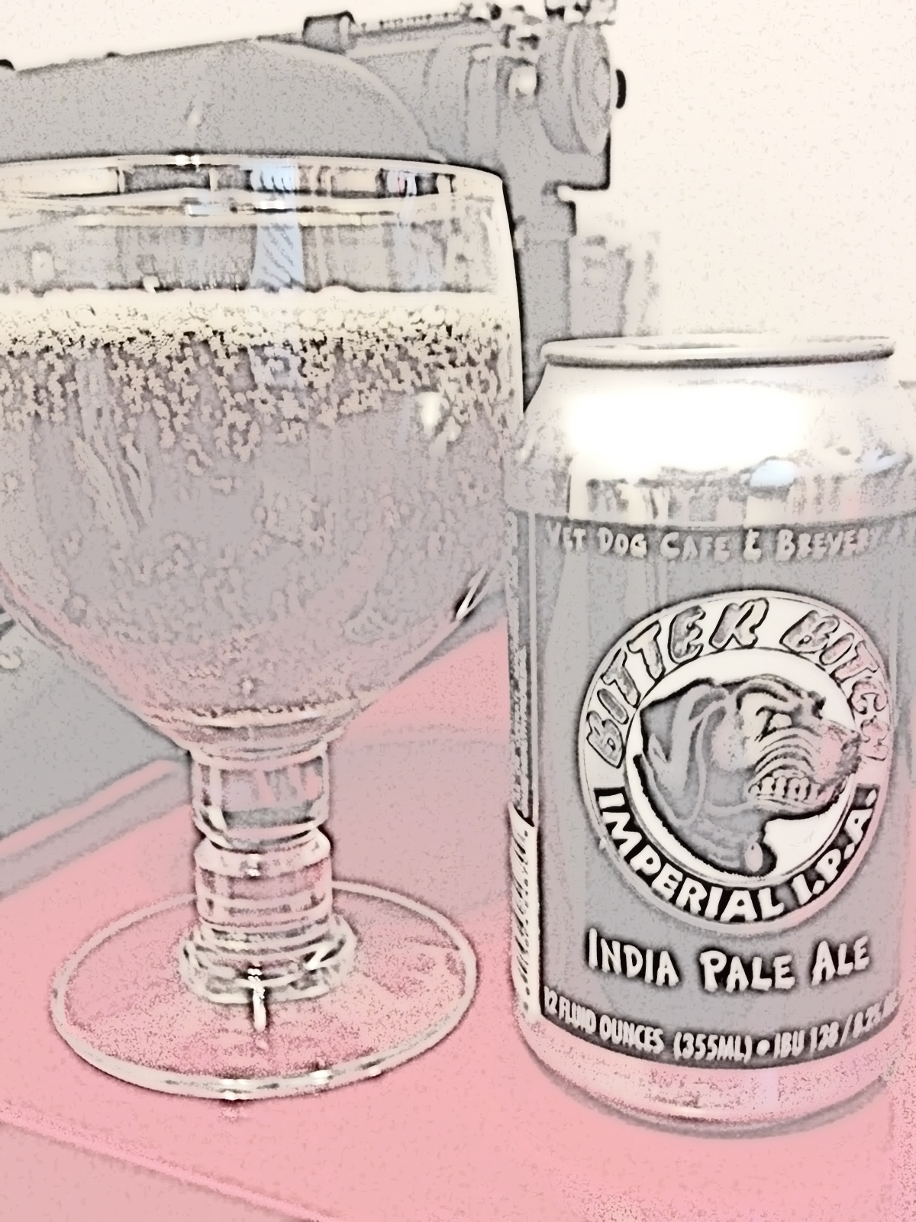

Most Interesting Beers
Most Alcohol
Most Bitter
Name: Lee Hill Series Vol. 5
Alcohol Content: 12.8%
State: Colorado
Brewery: Upslope Brewing
Style: Quadrupel (Quad)
Size: 19.2 oz
Name: Bitter Bitch
Bitterness: 138 IBU
State: Oregon
Brewery: Astoria Brewing Company
Style: American Double / Imperial IPA
Size: 12 oz

Slide 6
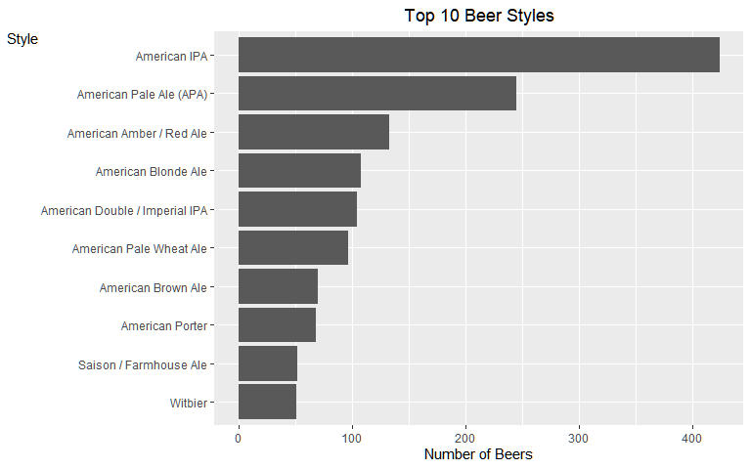

Most popular styles
Style
American IPA and Pale Ale are the most popular styles, with a total of 100 unique styles in this dataset
Number of Beers

Slide 7
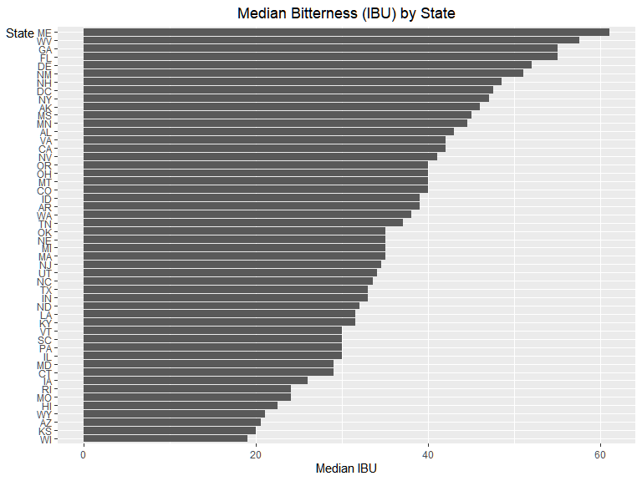

Which State Brews the most Bitter Beer?
Maine and West Virginia have the highest median bitterness. South Dakota did not have any bitterness observations.

Slide 8
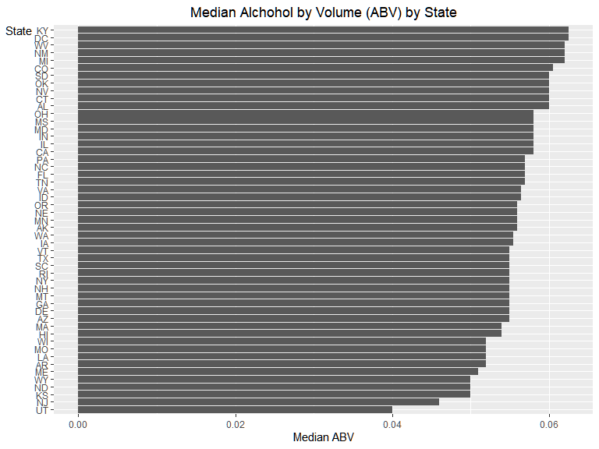

Which State Brews the most Alcoholic Beer?
Kentucky and DC produce the beers with the highest median alchohol by volume

Slide 9
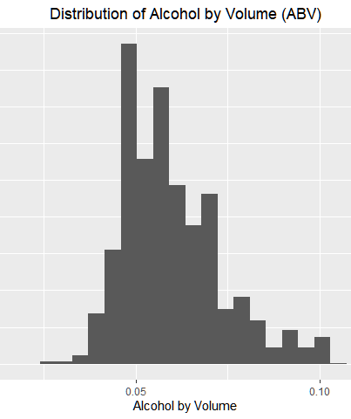
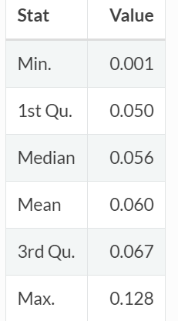

How much Alcohol is in US craft beer?
Most Beers have alcohol content between 5% and 6.7%.
It is rare for beer to exceed 10% ABV.

Slide 10
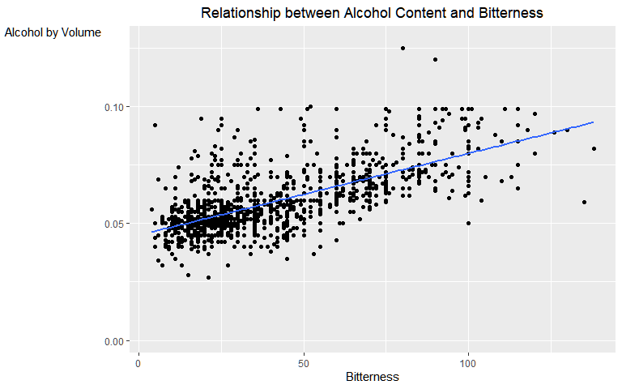

How are Alcohol Content and Bitterness Related?
Alcohol by Volume
There is evidence of a positive relationship between Alcohol Content and Bitterness.
Bud Light, InBev’s most popular beer, has an ABV of 4.2% and 6 IBU
Bitterness

Slide 11

Conclusions
Colorado and California have the most craft breweries
IPA and Pale Ale are the most popular styles
Craft Beers tend to have alcohol content between 5% and 6.7%
There is evidence of a positive relationship between alcohol content and bitterness in craft beers
Lee Hill Series Volume 5 is the most alcoholic craft beer (12.8%)
Bitter Bitch is the most bitter beer (138 IBU)

